Slide 1


Analysis and Uncovering the Emotions of Text
BY : Mohamed Magdy
Supervisor : Dr. Sara Sweidan

Slide 2


OutLine
What is sentiment analysis?
Types of sentiment analysis
Why it’s important?
How does it work?
Challenges
Applications

Slide 3
Introduction
Sentiment analysis (or opinion mining) is a natural language processing (NLP) technique used to determine whether data is positive, negative or neutral. Sentiment analysis is often performed on textual data to help businesses monitor brand and product sentiment in customer feedback, and understand customer needs.

Slide 4
What is sentiment analysis
Sentiment analysis is an automated process capable of understanding the feelings or opinions that underlie a text. It is one of the most interesting subfields of NLP, a branch of Artificial Intelligence (AI) that focuses on how machines process human language.
Also, Natural language processing (NLP): Together, these technologies enable computers to process human language in the form of text or voice data and to ‘understand’ its full meaning, complete with the speaker or writer’s intent and sentiment.

Slide 5
What is sentiment analysis(CONT)
Sentiment analysis studies the subjective information in an expression, that is, the opinions, appraisals, emotions, or attitudes towards a topic, person or entity.
Expressions can be classified as positive, negative, or neutral.
For example:
“I really like the new design of your website!” → Positive
“I’m not sure if I like the new design” → Neutral
“The new design is awful!” → Negative

Slide 6
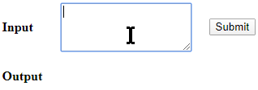
What is sentiment analysis(CONT)

Slide 7

What is sentiment analysis(CONT)

Slide 8
Emotion Recognition for Education using Sentiment Analysis
Year of publication: 14 September 2018
Author: Ramón Zatarain

Slide 9
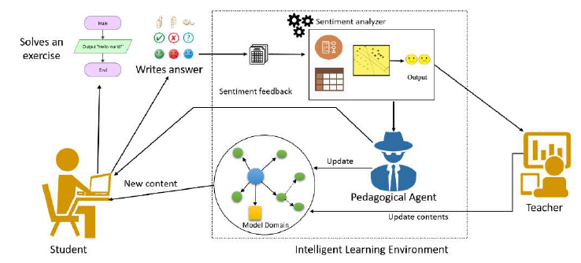
Methodology
The proposed methodology for the development of our work is based on the inductive scientific method that is organized into four stages: analysis, design, implementation, and testing. The monitoring of each stage will allow reaching the solution of the development of the system that performs the analysis of feelings.

Slide 10
TOOLS
The majority of emotion recognition systems used in learning systems are focused on detecting fundamental emotions like joy, sadness, or fury. However, an intelligent tutoring system must be able to identify secondary emotions such as boredom or frustration in a pupil. The majority of research on sentiment analysis in text focuses on distinguishing polarity (positive and negative). Therefore, some techniques are used to solve problems, which are:
CNN-LSTM model
Naïve Bayes and
SVM
KNN

Slide 11
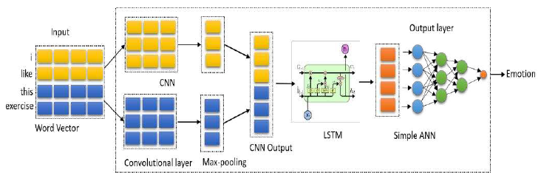
TOOLS

Slide 12
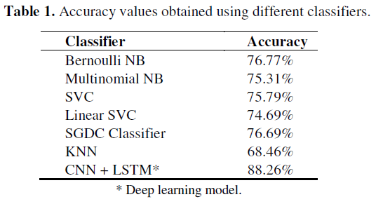
Accuracy
shows the accuracy values obtained according to the size of the corpus. The traditional ML classifier with the highest score was Bernoulli Naïve Bayes, with an accuracy of 76.77%. In general, Bernoulli Naïve Bayes is a robust classifier against irrelevant features and it is suitable for text classifying. On the other hand, the deep learning model reached a precision of 88.26%, surpassing the other classifiers.

Slide 13
An Application of Emotion Detection in Sentiment Analysis on Movie Reviews
Year of publication: 27 January 2021
Author: Ria Ambrocio Sagum

Slide 14
Methodology
The TF – IDF (Term Frequency-inverse Document Frequency) Algorithm Was Used To Transform Text Into Meaningful Representations Of Numbers In The System Designed For This Research. This Algorithm Takes Frequency (Term Frequency) Into Consideration And Penalizes Words For Being Overused (For Example, The Word "The" Would Be Downvoted Because It Is Too Popular). The Intuition Is That If The Word Is Used In Every Sentence, It Doesn't Have Discriminatory Power. Whereas Words May Be Able To Differentiate The Contents Of The Sentence More Effectively. The Technique Is Commonly Used In NIP Applications To Extract Features.

Slide 15
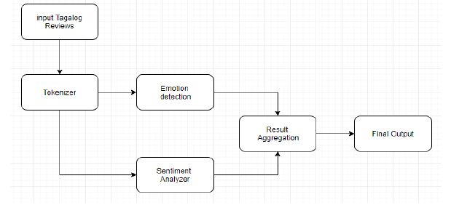
Methodology

Slide 16
TOOLS
Different tools can be used in this area like text classification. Text classification is a process of extracting textual data from reviews and classifying them into positive and negative polarity. Classification is performed by applying machine learning (ML) methods or Heuristic-based methods.
Support Vector Machine (SVM).
Naive Bayes (NB).
Maximum Entropy.
K-Nearest neighborhood

Slide 17
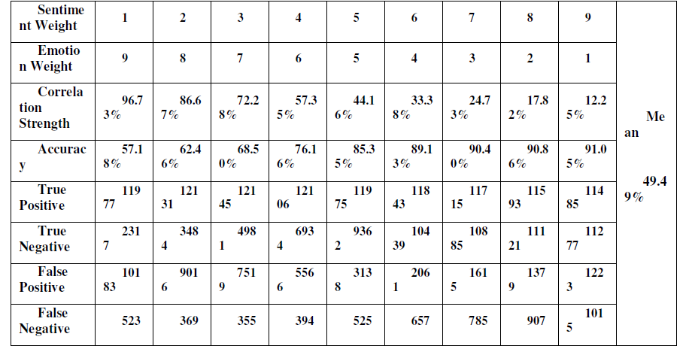
Accuracy
Correlation of Data is performed using Pearson R Test or Pearson correlation coefficient that measures the strength between variables and relationships. We can say that Emotion Detection can enhance the accuracy of the Sentiment Analyzer. The mean of correlation that is gathered by collecting correlation coefficients that result from different weights assigned to Emotion and Sentiment has a value of 0.494882667 (49.4%).

Slide 18
Sentiment Analysis Using Machine Learning Classifiers: Evaluation of Performance
Year of publication: 2019
Author: Shamantha Rai B & Sweekriti M Shetty.

Slide 19
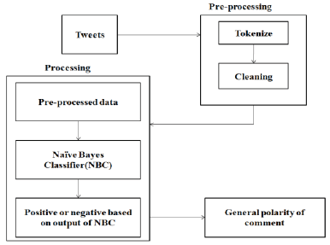
Methodology
First : preprocessing Tweets where tokenization and cleaning takes place.
Second : data then passed processing where Naive Bayes algorithm is applied
Third : output from algorithm is obtained in positive and negative opinion format.
Last : the general polarities of comments are decided.

Slide 20
Tools
Machine Learning algorithms analyze the data which helps in developing an analytical model. These algorithms will assess data continuously and interpret it to assess the hidden insights.
There is three machine learning classifiers used:
Random Forest
Naive Bayes
Support Vector Machine(SVM).

Slide 21
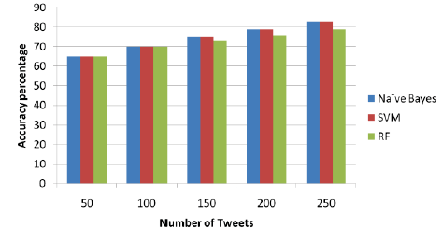
Weakness &Accuracy
It is observed that the accuracy of NB, SVM and RF hovers around 60% to 70 % for different sets of data, whereas increasing the number of tweets, will slightly increase the accuracy in each case of number of tweets.

Slide 22
Analysis of Machine Learning Algorithms for Opinion Mining in Different Domains
Year of publication: 8 December 2018
Author:Donia Gamal , Marco Alfonse, El-Sayed M. El-Horbaty and Abdel-Badeeh M. Salem

Slide 23
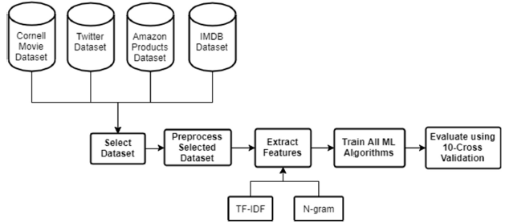
Methodology
First : dataset is selected from among the four different datasets
(IMDB dataset, Twitter dataset, Amazon products dataset, Cornell dataset).
Second : Pre-processing is performed in
Third : involves the FE algorithms that are applied on the selected dataset. Then : all ML algorithms are trained.
At The End: the different ML algorithms are evaluated.

Slide 24
Tools
The different ML algorithms These are Naïve Bayes (NB), Stochastic Gradient Descent (SGD), Support Vector Machines (SVM), Passive Aggressive (PA), Maximum Entropy (ME), Adaptive Boosting (AdaBoost), Multinomial NB (MNB), Bernoulli NB (BNB), Ridge Regression (RR) and
Logistic Regression (LR).

Slide 25
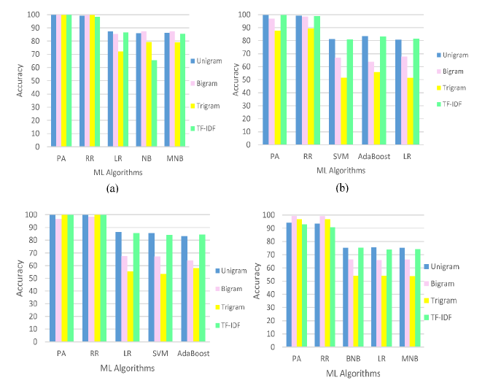
Weakness &Accuracy
The performance of the PA and RR with different FE algorithms on various datasets is the best among other algorithms as they give the highest accuracies in a range between 87% and 99.96%.

Slide 26
Sentiment and Emotion Analysis for Social Multimedia: Methodologies and Applications
Year of publication:2016
Author : Quanzeng You
Problem definition: Analysis of online sentiment changes for social media users using text and visual content. in this time

Slide 27
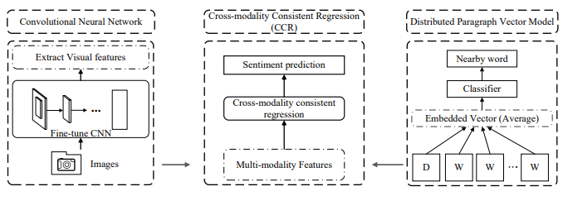
Methodology
1.Convolutional Neural Network:
We'll need a lot of high-quality photos
to train a convolutional neural network.
However, when it comes to visual sentiment
analysis . A substantial percentage of training
instances can still be classified by the neural
network. As a result, we propose gradually
reducing the effect of noise by selecting a
subset of training states.
2.CCR:Multimedia features need to be
challenged by consistent regression to predict sentiment
3. Distributed Paragraph Vector Model:
When predict sentiment The Embedded Vector (makes a choice Classified Nearby word

Slide 28
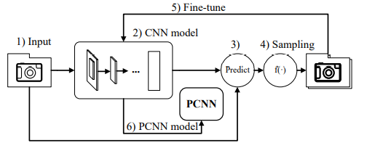
Tools
CNN&PCNN :depicts the anticipated progressive CNN’s Overall flow (PCNN). On Flickr photos, we first train a CNN. Following that, we choose training samples based on the trained model's prediction score on the training data.
Rather than starting from scratch, we use these newly selected, and potentially cleaner training cases to fine-tune the learned model.

Slide 29
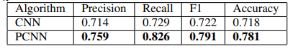
Weakness &Accuracy

Slide 30
Random Forest And Support Vector Machine Based Hybrid Approach To sentimental Analysis
Year of publication: 2018
Author : Elsevier B.V.

Slide 31
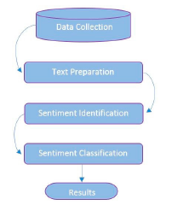
Methodology
First : text pre-processing and cleaning on the dataset which including removal of stop words.
Second : Sentiment identification step determines the sentiment of people expressed in the text and analyzes it
Finally : sentiment classification is conducted to get the results .

Slide 32
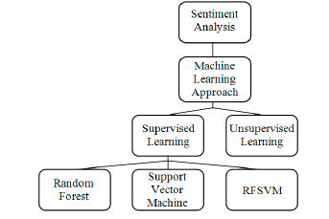
Tools
the classification of sentiment using three algorithms, Support Vector Machine (SVM) , and Random Forest (RF), random forest support vector machine (RFSVM).

Slide 33
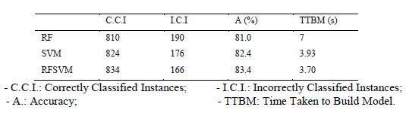
Weakness &Accuracy
At RF: we see that 810 reviews are correctly classified among 1000.
At SVM: we see that 824 reviews are correctly classified among 1000.
At RFSVM: we see that 843 reviews are correctly classified among 1000.
it is represented that the accuracy computed in the case of proposed method (RFSVM) is better as compared to random forest and support vector machine.

Slide 34
Emotion And Sentiment Analysis From Twitter Text
Year of publication: 16 May 2021
Author : amulya Chenna , B.Srinivas , s.Nagaraju

Slide 35
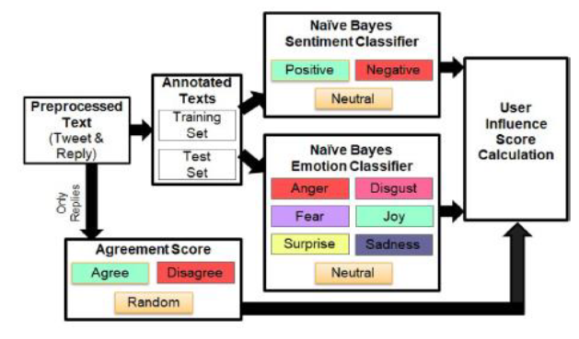
Methodology
First : They separated the preprocessed text into training and test sets for sentiment and emotion classifications.
Then : satisfied emotion and sentiment into the estimate of “user influence score,” which also managed the responses' compliance score.

Slide 36
Tools
In this approach they use Naïve Bayes classifier to classify the emotion relevant text from the twitter, re-twitter text .

Slide 37
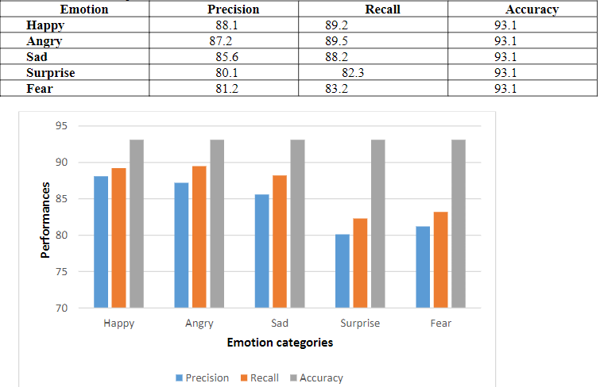
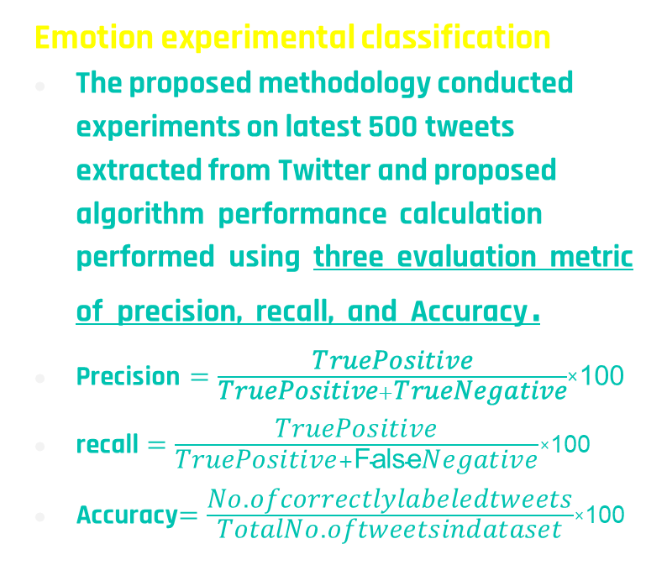
Weakness &Accuracy
Emotion experimental classification
The proposed methodology conducted experiments on latest 500 tweets extracted from Twitter and proposed algorithm performance calculation performed using three evaluation metric of precision, recall, and Accuracy .
$\text{Precision}=\frac{\text{TruePositive}}{\text{TruePositive}+\text{TrueNegative}}$×100
recall $=\frac{\text{TruePositive}}{\text{TruePositive}+\text{False}\text{Negative}}$×100
Accuracy$=\frac{\text{No}\text{.}\text{ofcorrectlylabeledtweets}}{\text{TotalNo}\text{.}\text{oftweetsindataset}}$×100

Slide 38
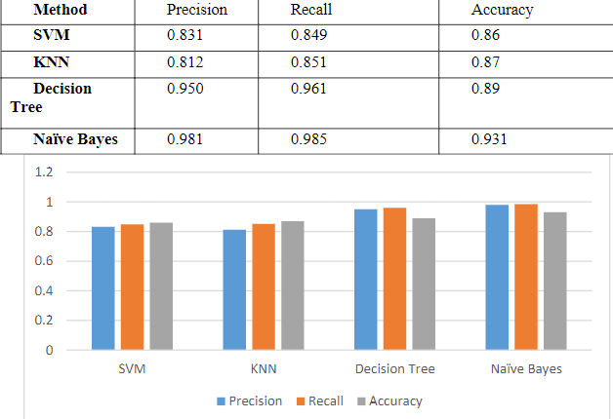
Weakness &Accuracy
Comparison between various classifications

Slide 39
Text-based emotion prediction system using machine learning approach
Year of publication: 2020
Author : Ahmad Fakhri Ab.Nasir, Eng Seok Nee, Chun Sern choong ,Ahmad Shahr

Slide 40
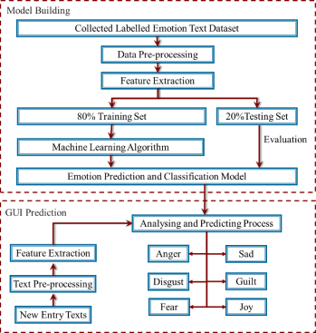
Methodology
Model of Emotions : The emotions selected were categorized into two main sections, negative and positive.
Data Source : ISEAR (The International Survey on Emotion Antecedents and Reactions) ,NLTK (Natural Language Toolkits).
Programming Language and Tools :
Python programming language
Tool :(i) Pandas, (ii) Scikit-learn (sklearn), (iii) (NLTK), (iv) Numpy, (iv) Matplotlib
, (v) TextBlob toolkits, and (vi) Tkinter (GU toolkit)
Model Development :
splitting the dataset into training and testing
the labelled emotion text undergoes data pre processing
feature extracting processes.

Slide 41
Tools
In this approach they use Multinomial Naïve Bayes classifier,
Support Vector Machine (SVM) , Decision trees (DT)

Slide 42
Accuracy
Multinomial Naïve Bayes classifier illustrated a better performance with highest accuracy mean score (64.08%) compared to SVM (15.37%), Decision Tree classifiers (52.36%) and k-NN (47.95%).
Multinomial Naïve Bayes classifier is selected as the machine learning algorithm in this project

Slide 43
Emotion Detection of Tweets using Naïve Bayes Classifier
Year of publication: 2017
Author : Hema Krishnan , M. Sudheep Elayidom
, T. Santhanakrishnan

Slide 44
Methodology
First : Fetching tweets
1. Twitter OAuth
2. Extraction of tweets
Second : Processing and storing tweets
Third : Extraction of emotions from MongoDB

Slide 45
Tools
In this approach they use Naïve Bayes classifier , MongoDB database is a NoSQL document oriented database which stores the data in JSON format.

Slide 46
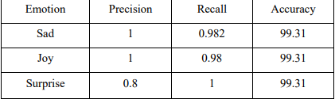
Accuracy
the precision, recall and accuracy corresponding to the emotions sad, joy and surprise extracted from latest 500 tweets .

Slide 47
Emotion Detection and Recognition from Text using Machine Learning
Year of publication: June 2018
Author : Shaikh Abdul Salam, Rajkumar Gupta

Slide 48
Methodology
First : Collecting Data :
A) The Tweet Retrieval module works on multiple languages by fetching the tweets based on the selected region.
B) provided to the Emotion Tagger module that converts each incoming tweet into a vector of 8 basic(Anger ,Fear , Sad , Surprise , Trust ,Disgust , Anticipation , Enjoyment) emotions
C) These vectors are then fed into supervised learning techniques SVM and Naive Bayes which returns a emotion label for the given tweet.
Second : Generating dataset :
A) Total of 100 word are first converted into hashtags and then fed into The Tweet Retrieval System (TRS).
B) The TRS keeps on listening to the live tweet stream and captures any tweets with the hashtag that is passed to it.
Labelling of training dataset is automated label which is one of the basic emotion family to which the hashtag word belongs

Slide 49
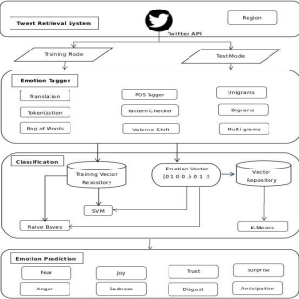
Methodology cont.
Then : Pre-processing Data and Collecting Corpus
Finally : takes a sentence as input, performs calculation and gives the vector as output. These vectors are then used to train our supervised learning classifiers - SVM and Naive
Bayes.
Linear Kernel for SVM is used for implementation.
After the SVM and Naive Bayes classifiers are trained, live tweets can be fed into them to determine the emotion type.

Slide 50
Tools
In this approach they use Multinomial Naïve Bayes classifier (NVC), Support Vector Machine classifier (SVM) , K-Mean classifier

Slide 51
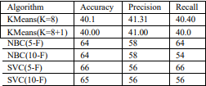
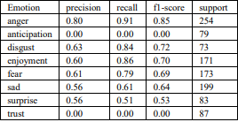
Accuracy
Accuracy Baseline 1: 23.45 %
Accuracy Baseline 1 mentioned above has been calculated
from training data set where Anger was the most prevalent
emotion. For training, a total of 13000+ tweets were used.
Anger: 3220 / 13731 = 23.45%
Accuracy Baseline 2: 39.6 %

